Slide 1
Experiment – 5 User Interface Design USER FLOW and TASK ANALYSIS 230701222 Omesh . B

Slide 2
User flow:
It is the visual representation of the steps user takes to complete a task within an application or website.
It is the navigation of the user from a start action to the end action to complete the necessary task that needs to be completed.

Slide 3
Task Analysis:
Task analysis is the breakdown of tasks on what the user has to perform to accomplish their goals by examining each step they take, identifying potential problems and hence optimizing the user experience.
Only with user flow there exist a task analysis. If we know the start and end point of a task (User flow) you can decide the steps to take and analyze (Task analysis) for enhanced user experience.

Slide 4
About the Online software
We will be using an online software called Lucid chart to perform User Flow and Task analysis:
Lucid Chart
Lucid chart helps us to draw flowcharts that helps us understand user flow and task analysis in a better way visually.
Below is a picture of User flow and Task analysis flow chart performed on the topic Online shopping.
Drive link for clear picture: Flow chart picture

Slide 5
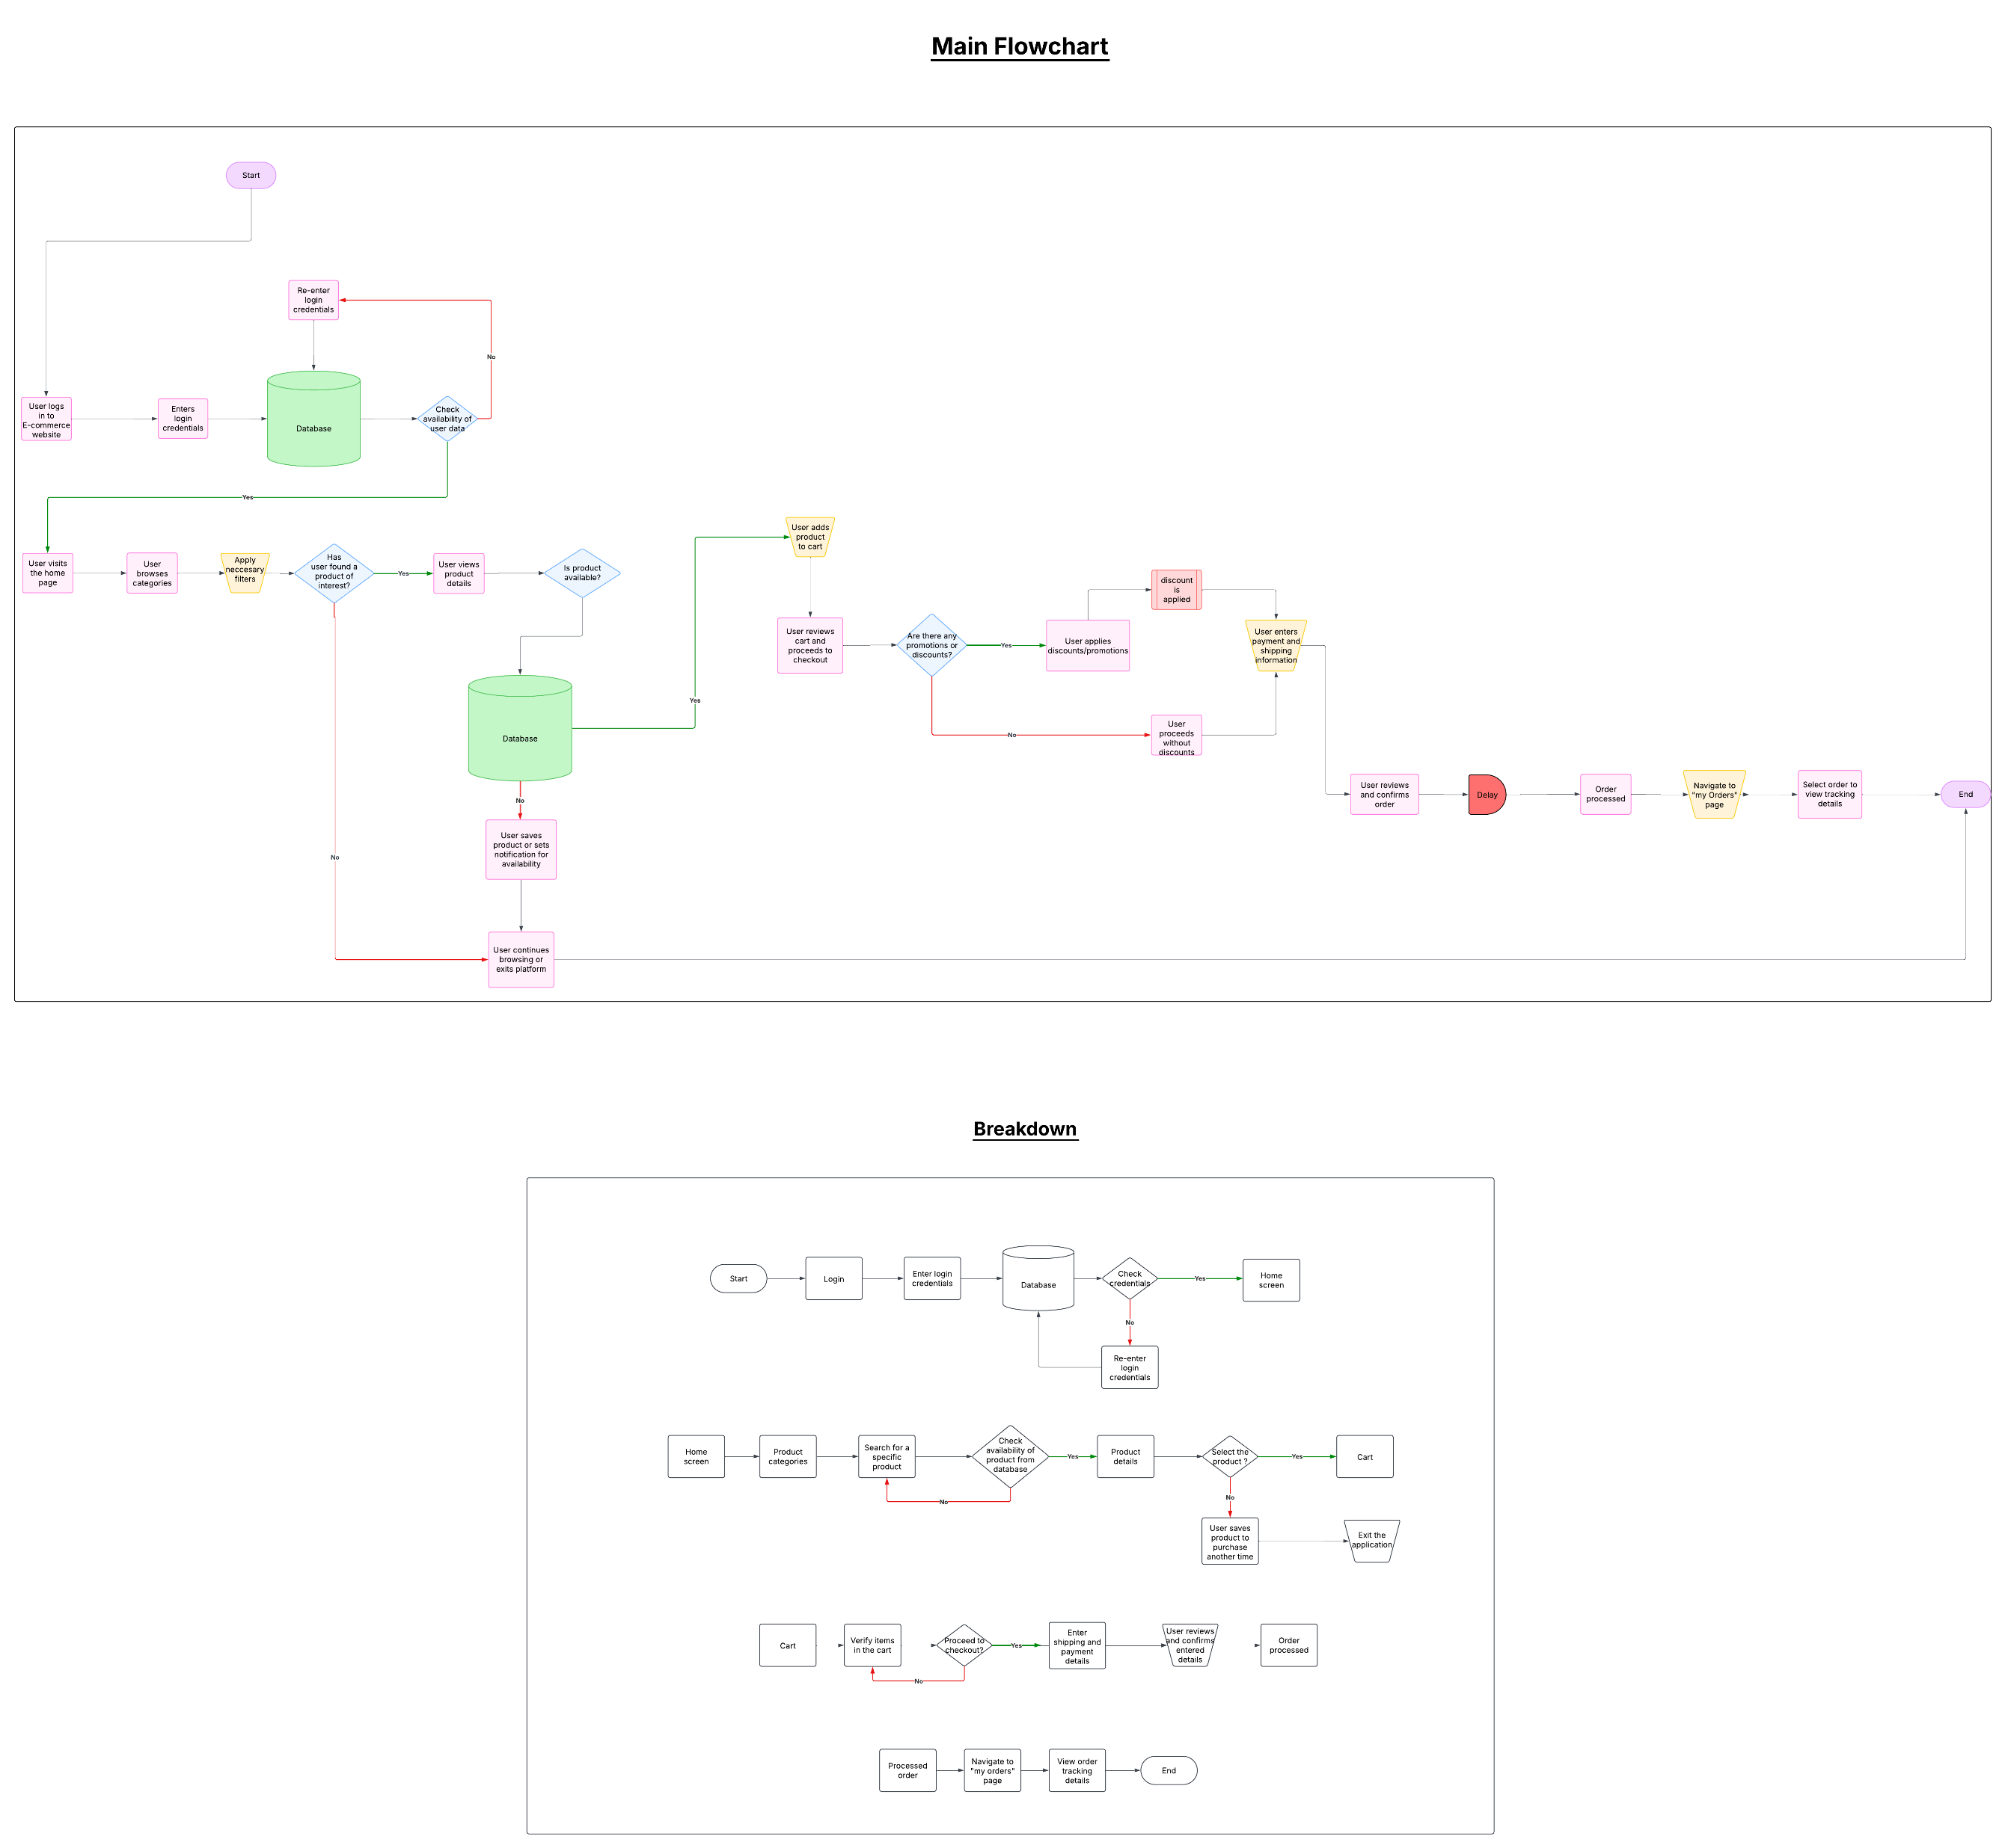

Slide 6
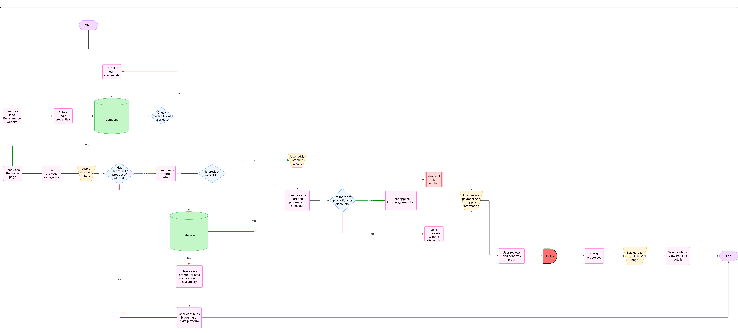
The main flow chart

Slide 7
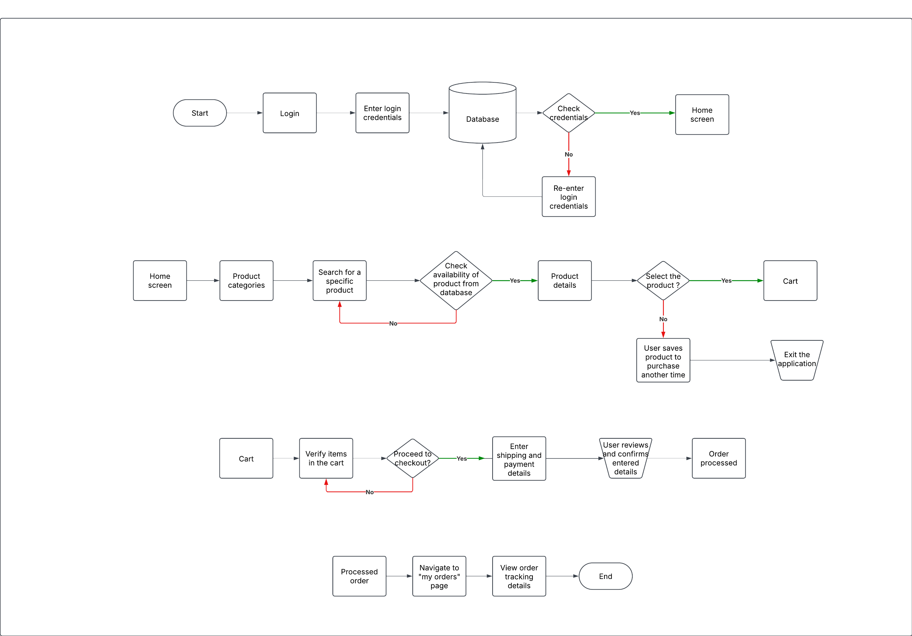
The Break down

Slide 8
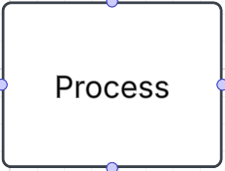
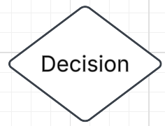
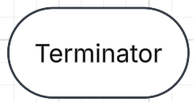
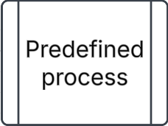
Shapes used in the flow chart
- This shape is to indicate the process that is being
performed by the user or in the backend
- This shape is to indicate the action in terms of decision (Yes/no) for certain upcoming events.
- This shape is to indicate the ‘Start’ and ‘End’ of the flow chart.
- This shape is to indicate a process that already ready to be
performed, only when the flow reaches that particular process
(eg: from the flow chart, discount is applied based on this)

Slide 9
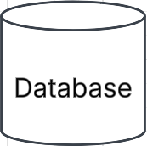
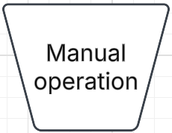
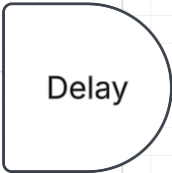
- This shape is to indicate the data that is stored at one place.
- This shape is to indicate certain tasks that user has to do on their own.
(Eg: entering shipping and payment details).
- This shape is to indicate the delay in a process in some part of the flow.

